Slide 1
Analyzing Elective Choices of Bachelor Students at Innopolis University using Basket Market Analys
Magzumov Davlatkhodhza B20CS01

Slide 2
Introduction
In my internship, I aimed to explore the connection between Bachelor students' academic tracks and their elective choices at Innopolis University. To achieve this, I employed Basket Market Analysis, a data-driven approach widely used in market research and recommendation systems.

Slide 3
Introduction
Basket Market Analysis allowed us to identify patterns and associations within the elective choices made by students, offering valuable insights into their decision-making processes. By understanding these preferences, Innopolis University can better tailor its elective offerings to enhance students' academic journeys.

Slide 4
Methodology
Data was collected from student distributions in tracks and elective course distribution. It structure was modified to make it anonymized and convenient for the experiment.
At all, there was chosen 2 years span of tech and humanitarian courses for BS21 students.

Slide 5
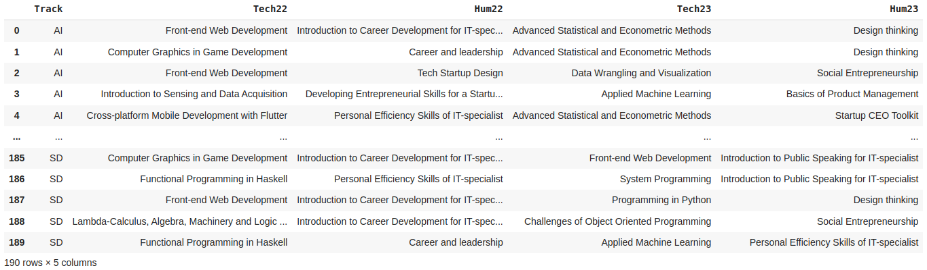
Methology
Pic. 1 Dataframe for pandas

Slide 6
Methodology
Once the data was collected, I proceeded with the application of Basket Market Analysis (MBA) to explore the relationships between academic tracks and elective choices. MBA involves identifying frequent itemsets and association rules to uncover patterns within the data.
To conduct the analysis, we transformed the survey data into transactional data, where each respondent's elective choices were treated as a transaction. The elective courses selected by each student formed the items in the transaction.
We then applied the Apriori algorithm, a widely-used association rule mining technique, to the transactional data. This algorithm allowed us to extract association rules that show the likelihood of certain electives being chosen together based on academic tracks.

Slide 7
Methodology
Throughout the experiment, we strictly adhered to ethical guidelines to protect the privacy and rights of the participants. The data was anonymized and aggregated, ensuring that individual identities remained confidential.
Any personal data collected during the survey was handled with utmost confidentiality and solely for research purposes.

Slide 8
Experiments results
For every track we can see what elective they will likely chose which will help us understand do they chose their elective based on it’s content which is suitable for their track or just choose a random one.

Slide 9
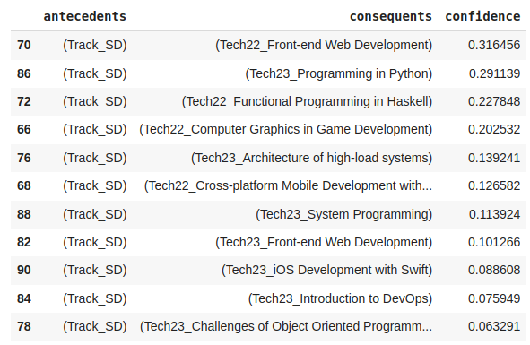
Experiments results
Let’s take a look at Pic. 2. From here we can see that students from that student mostly choose Fronted and programming languages, but don’t choose something regarding to math, devops or AI.
Pic. 2 Recommendation for SD on Tech courses

Slide 10
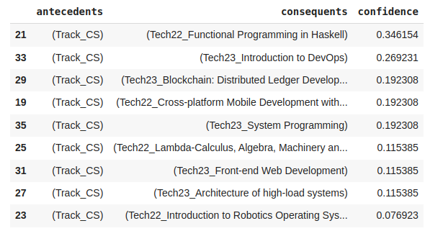
Experiments results
On the other hand, we can look at the Pic. 3. We can see that CS students choose something related to Linux and security.
Which means students choose their tech electives depending on their track
Pic. 3 Recommendation for CS on Tech courses

Slide 11
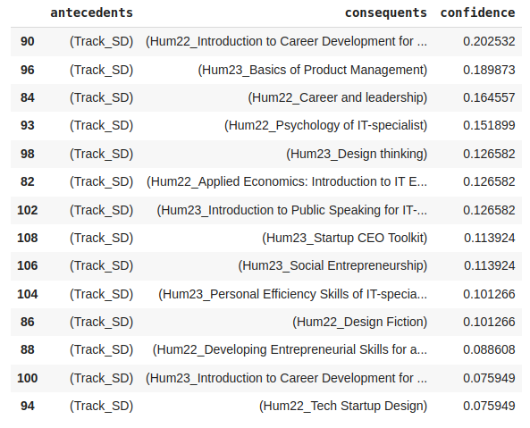
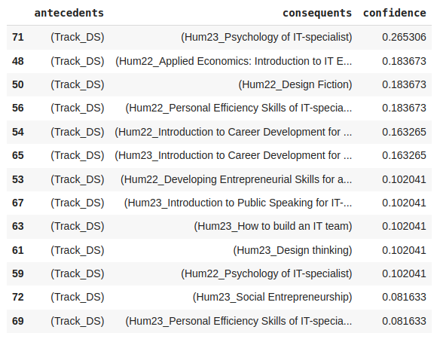
Experiments results
In humanitarian electives we can see some connection, but it is hard to say was it depending on track or just to find an easy elective.
Pic. 4 Recommendation for SD on Hum courses
Pic. 4 Recommendation for DS on Hum courses

Slide 12
Result of the internship
At the result I wanted to give a suggestion for elective courses distribution, but from the experiment I saw that everything is mostly fine, and we can consider a plus point for those who are making this distributions.
Also I will leave my code, which is scalable and can be reused if there will be better data.

